Slide 1


Exploring Brain Waves: A Practical Workshop on the Fundamentals of EEG Data Collection and Visualization
Scientifically supported by the department of Cognitive Science and Artificial Intelligence led by Marie Postma.
Financially supported by Province North Brabant via grant no. C2314216/5277363

Slide 2
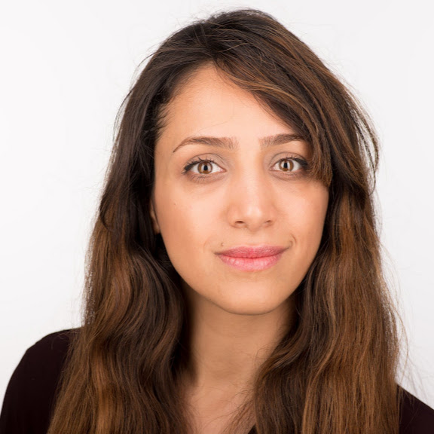
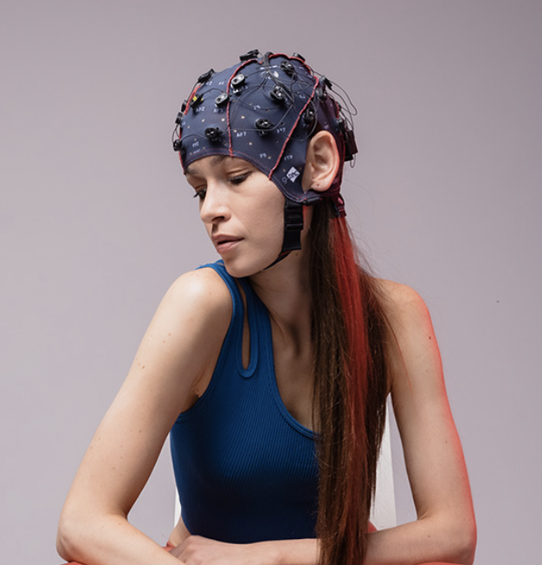
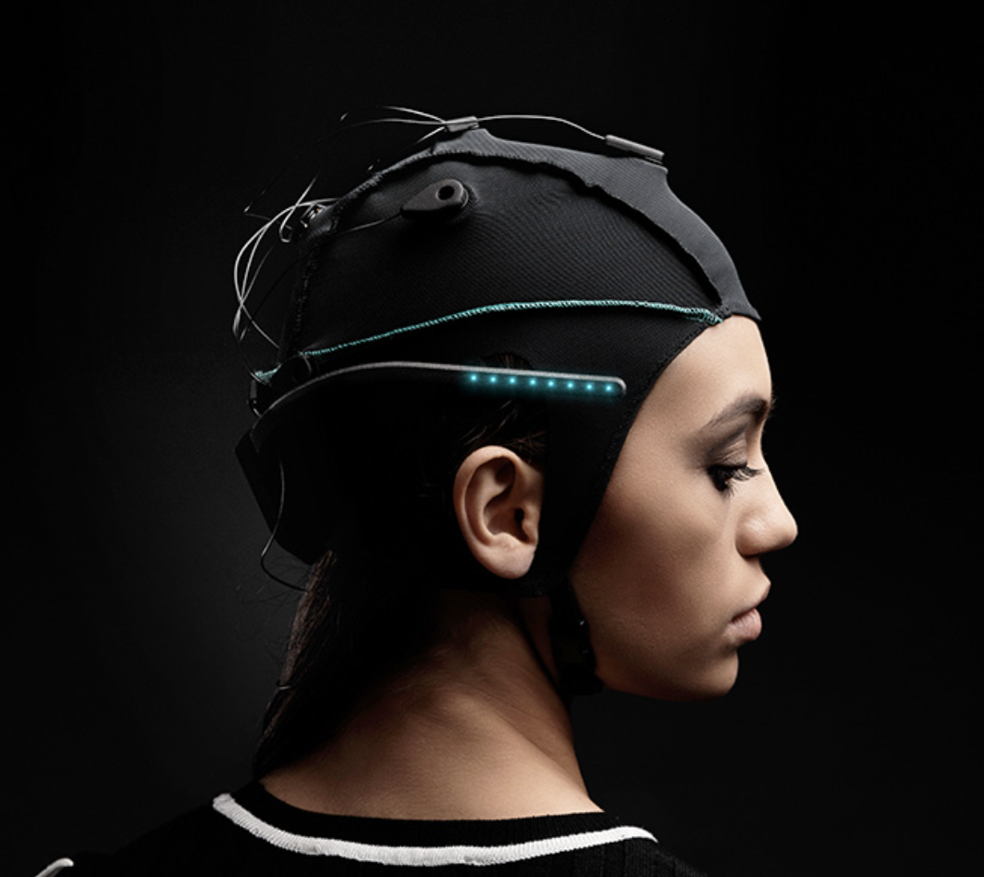
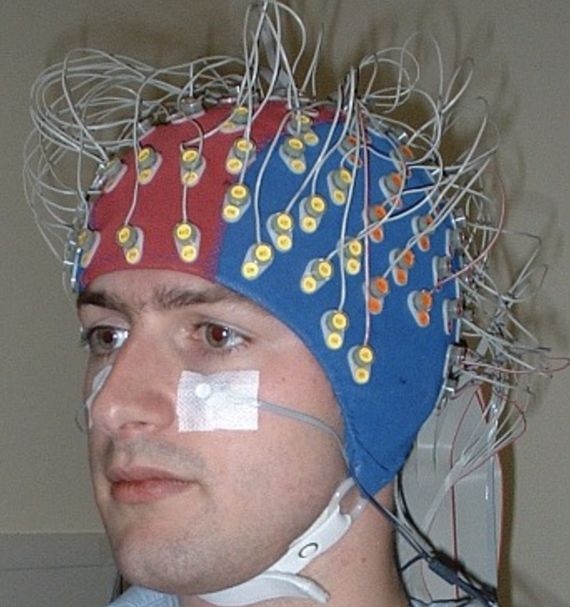
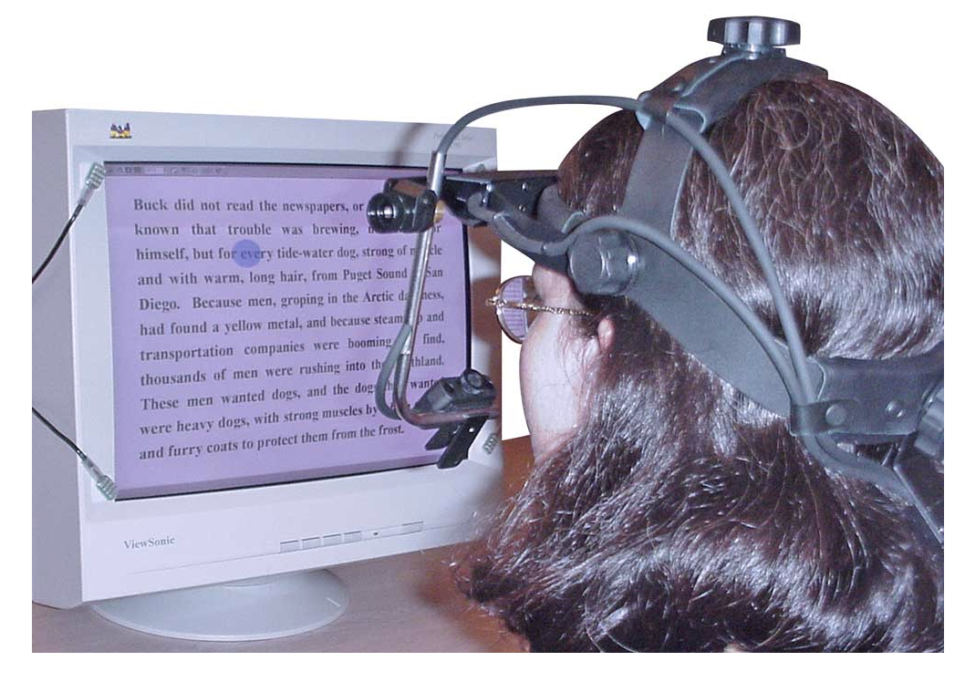
Brain and Behavior Lab coordinator at Mindlabs.
The lab started from Spring 2023 under supervision of
Dr. Harm Brouwer & Dr. Myrthe Faber
Lab activities:
To conduct Behavioral, EEG, Eye tracking studies.
To host a prestigious BCI competition: hackathon.
Faezeh Pourhashemi
s.f.pourhashemi@tilburguniversity.edu
EEG recorders: G.nautilus, Hybrid black unicorns, Biosemi.
Eye tracker: Eyelink.
​
PhD student in Cognitive Neuropsychology.​
Thesis: Multisensory speech perception.​

Slide 3
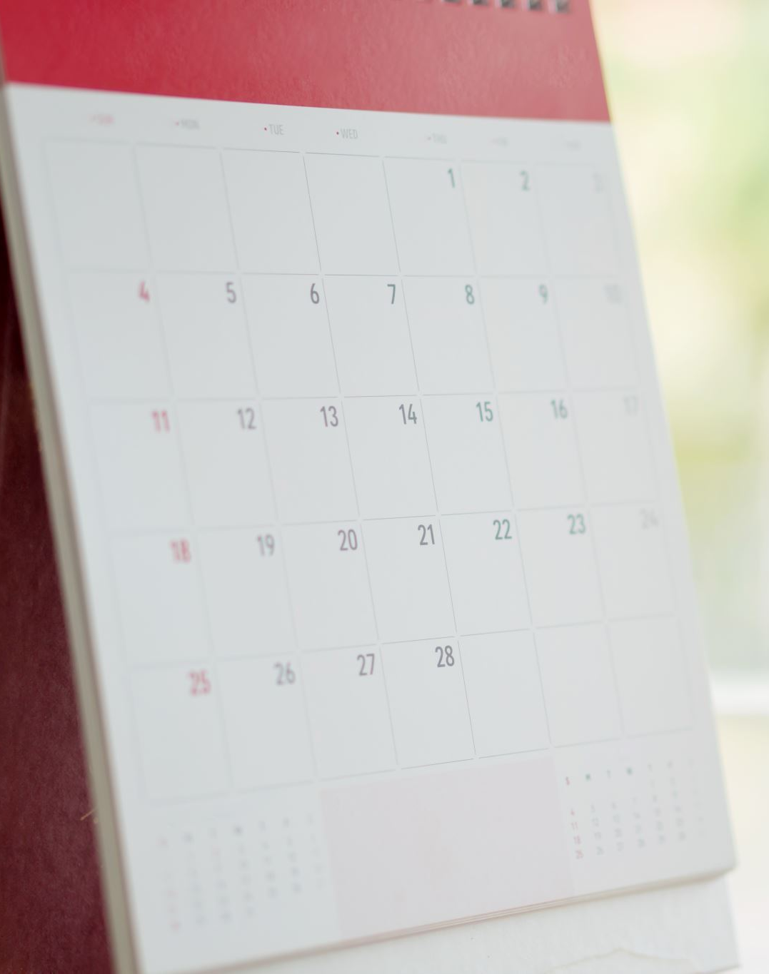
Today's schedule:
10:50-12:00
General theory
Intro to the EEG recording environment (Simulink)
12:00-12:25
Lunch break
12:30-14:00
EEG Prep + Practical
Mini ERP experiment
Preprocessing EEG signals

Slide 4
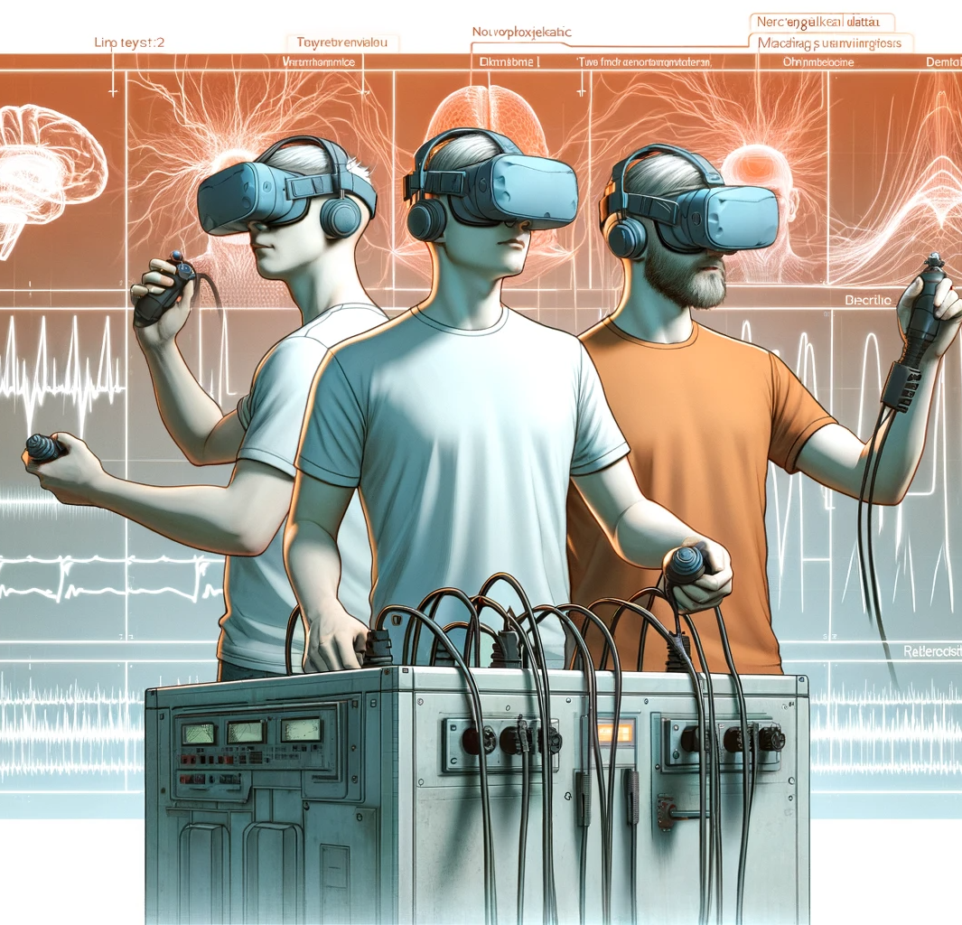
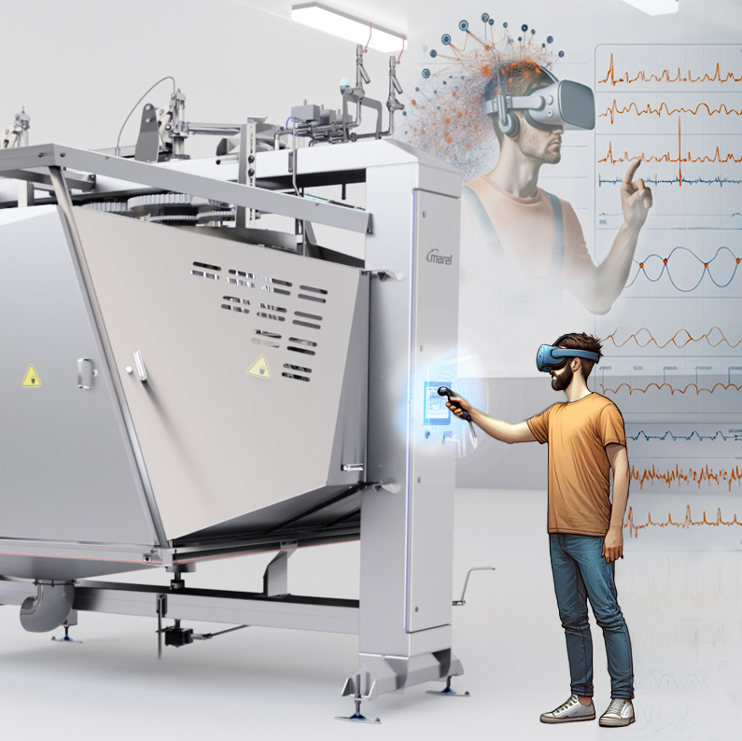
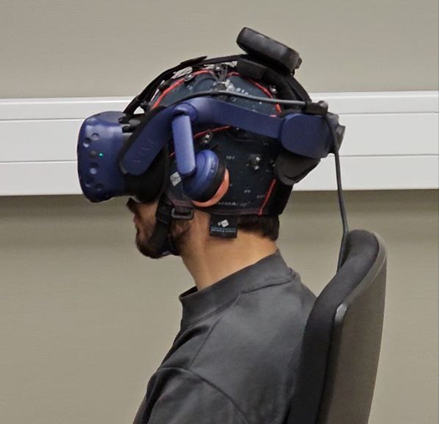
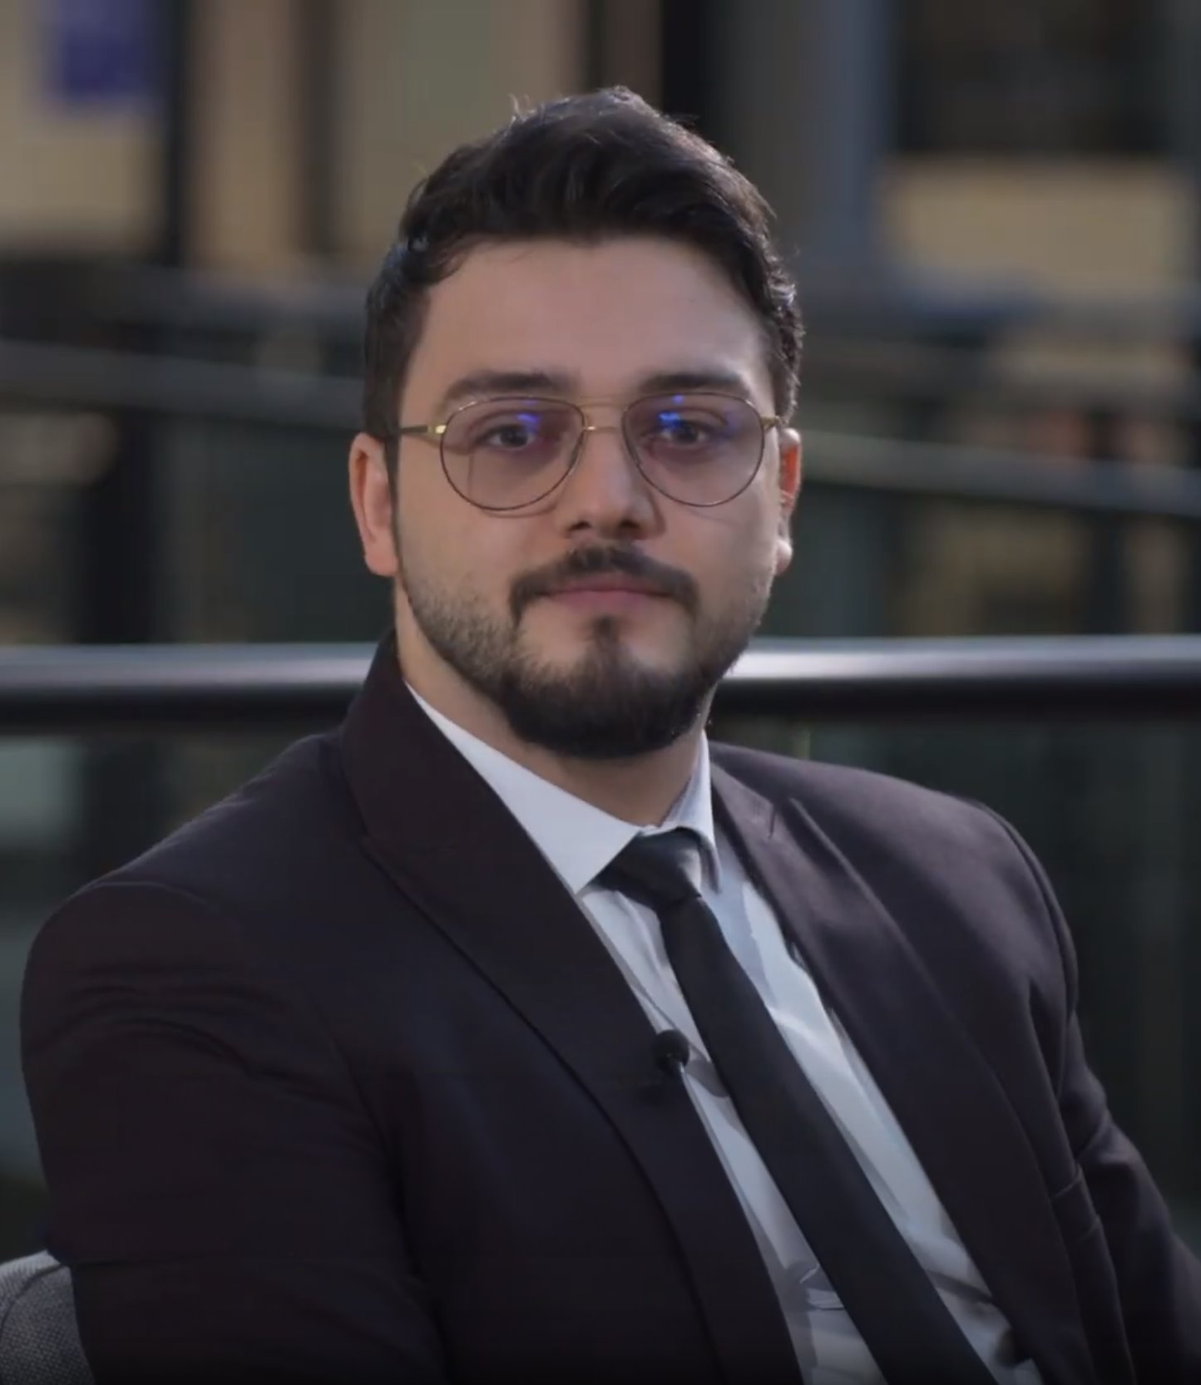
Ali Mousavi smousavi@uvt.nl

Slide 5
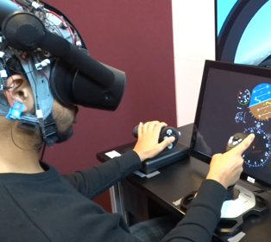
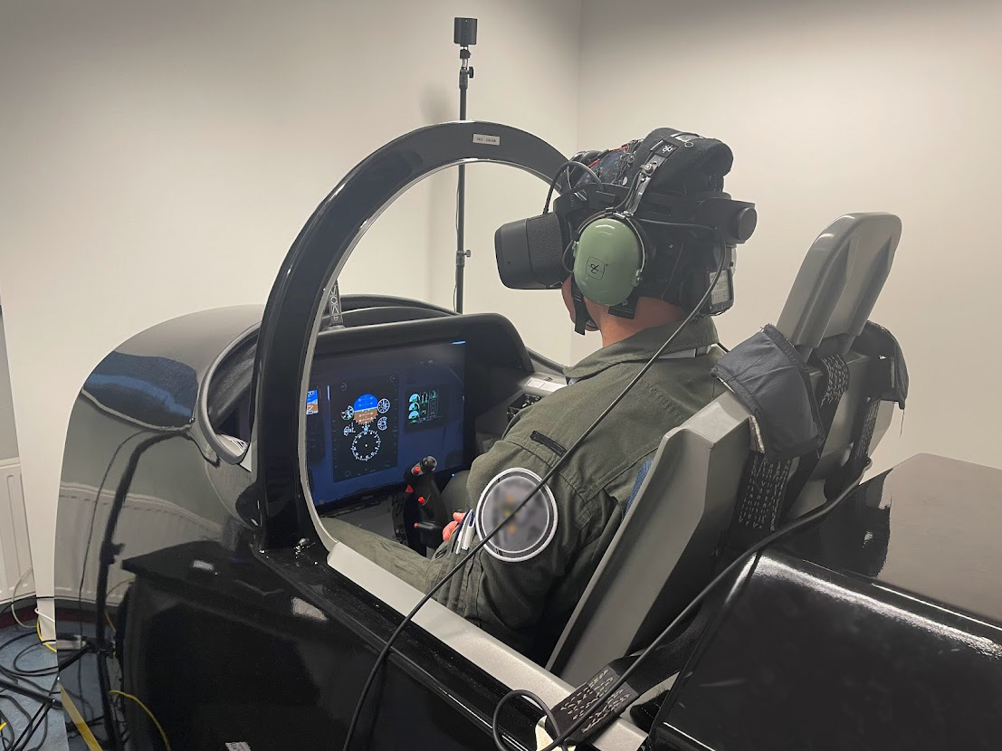
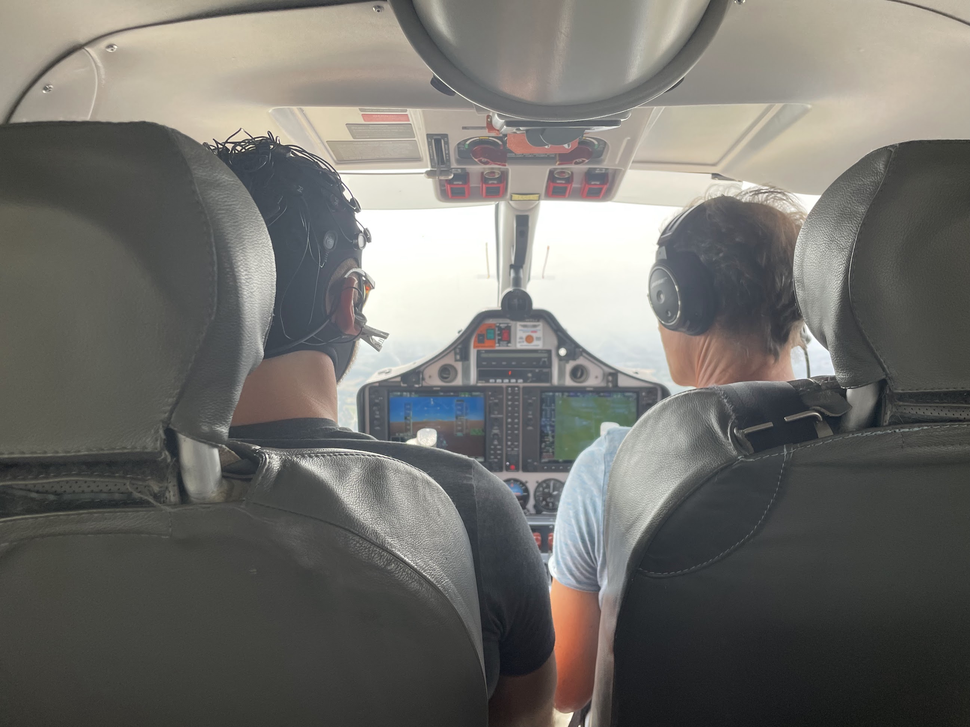
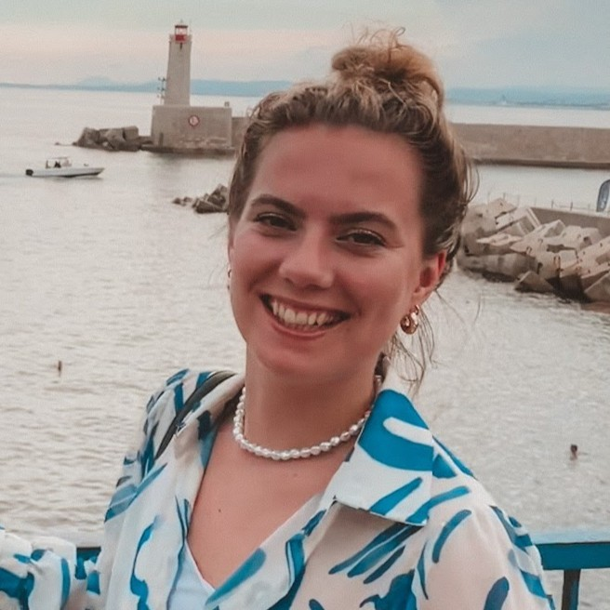
Evy van Weelden e.vanweelden@uvt.nl

Slide 6

What is EEG?

Slide 7
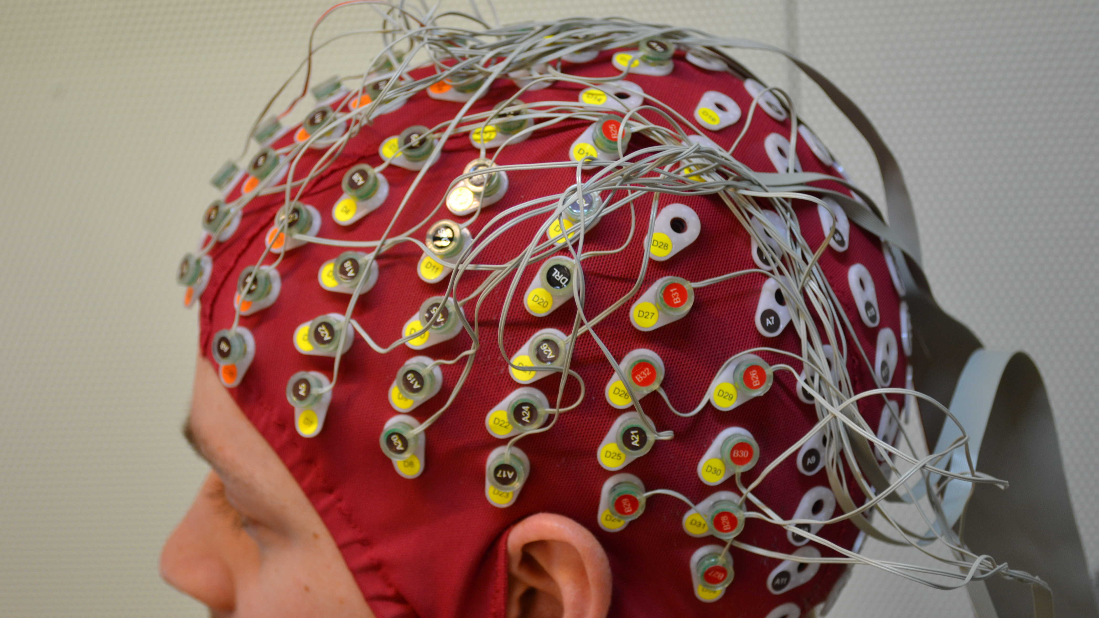
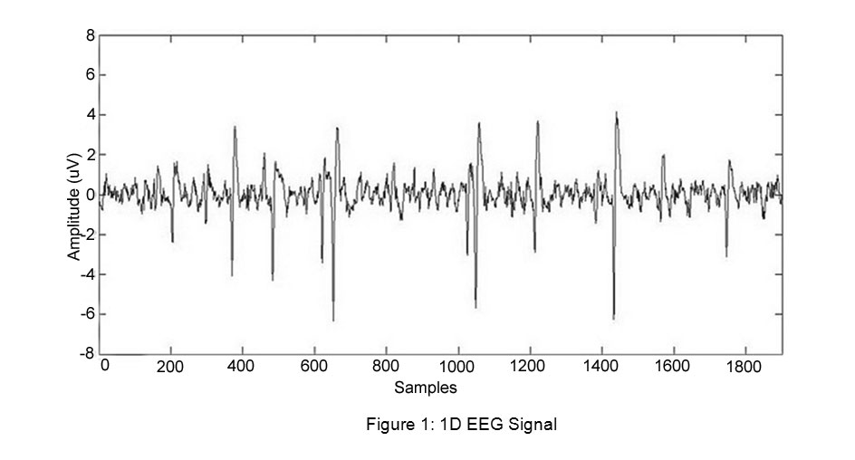
The basics
ElectroEncephaloGraphy
Electrical brain activity
"Brain waves"
Changes in milliseconds
Deze foto van Onbekende auteur is gelicentieerd onder CC BY.

Slide 8
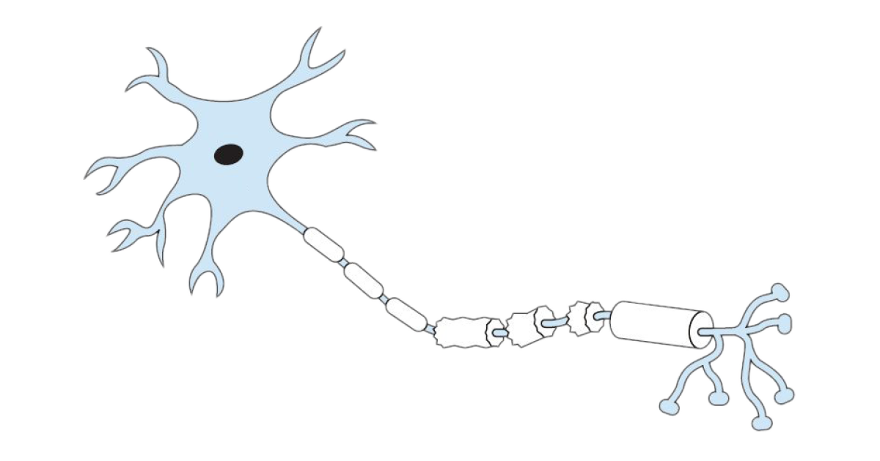
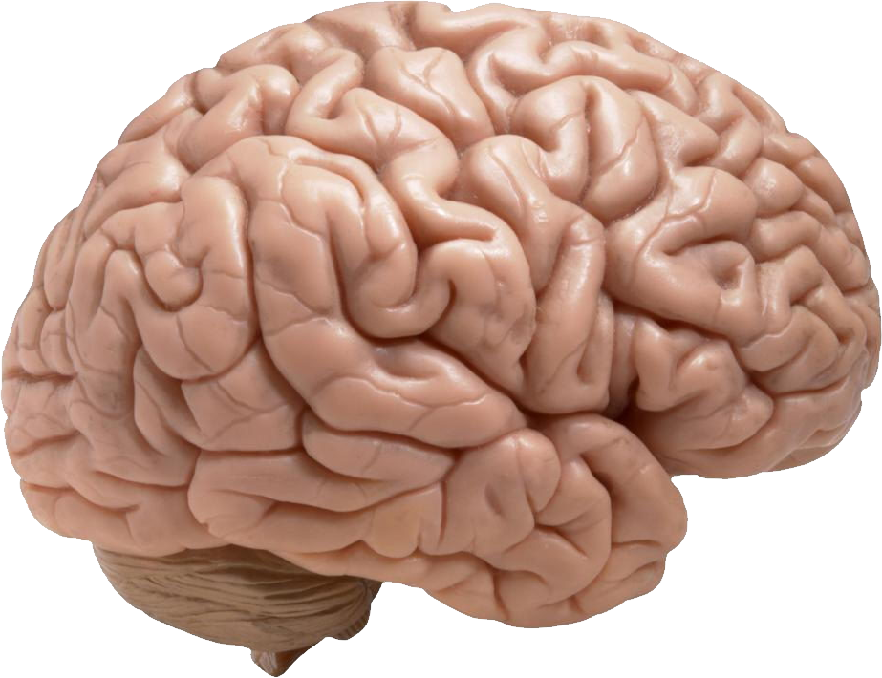
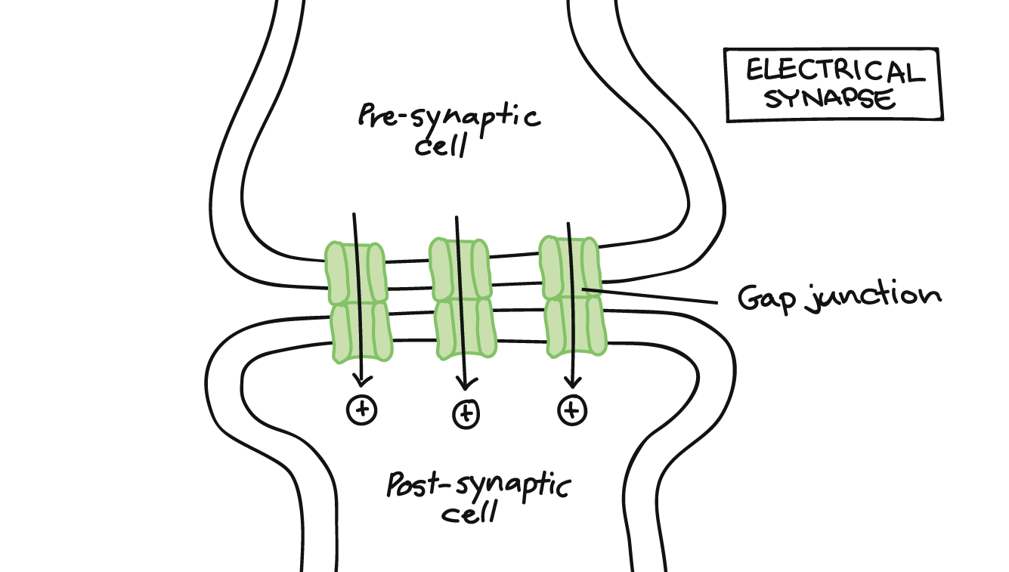
Background
Let's zoom in...
The brain
Neurons (brain cells)
Synaps – connection between cells

Slide 9
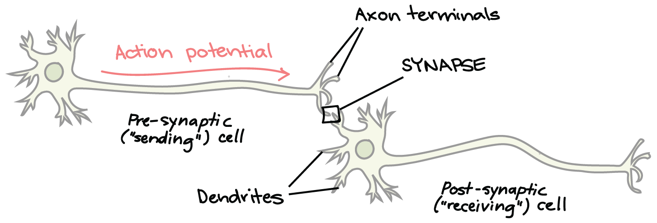
Background
Release of neurotransmitters, such as dopamine!
More neural activity = more electrical charges!
Thus: EEG electrodes detect synchronous electrical charges of groups of neurons...
Your brain generates enough electricity to power a lightbulb!

Slide 10
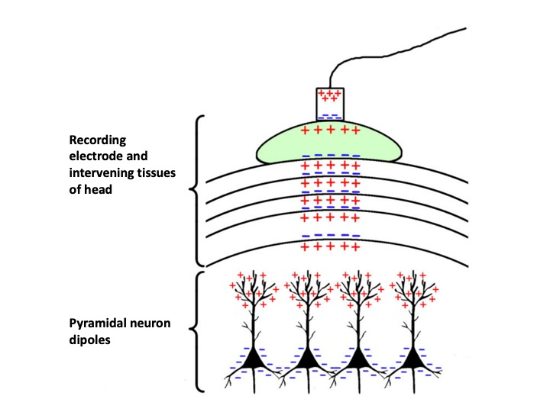
Background
Upper layer of cortex typically densely filled with pyramidal neurons
oriented perpendicular to the surface of the skull
*dipole = region of positive charge separated from a region of negative charge
(voltage difference can be measured by electrode)

Slide 11
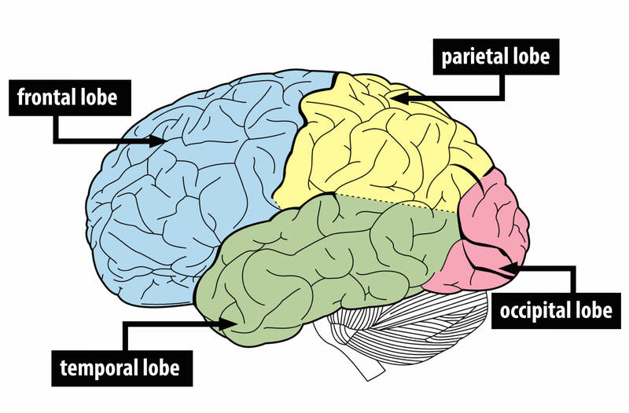
Interpretation of EEG signals
Frontal lobe - executive functions, decision making
Parietal lobe - spatial processing, (visual) attention, information processing
Temporal lobe - speech, memory
Occipital lobe - visual processing

Slide 12
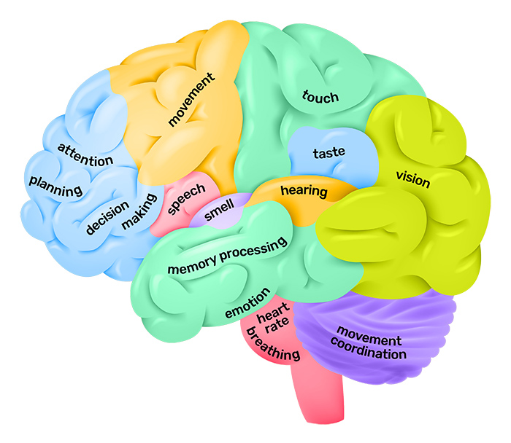
Source: the University of Queensland - Queensland Brain Institute

Slide 13
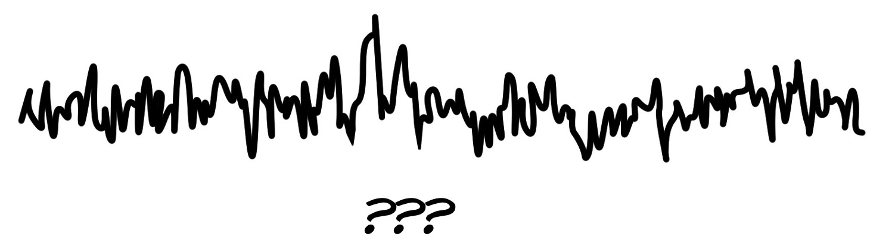
Interpretation of EEG signals
Decomposing the EEG signal into frequency bands
Raw EEG

Slide 14
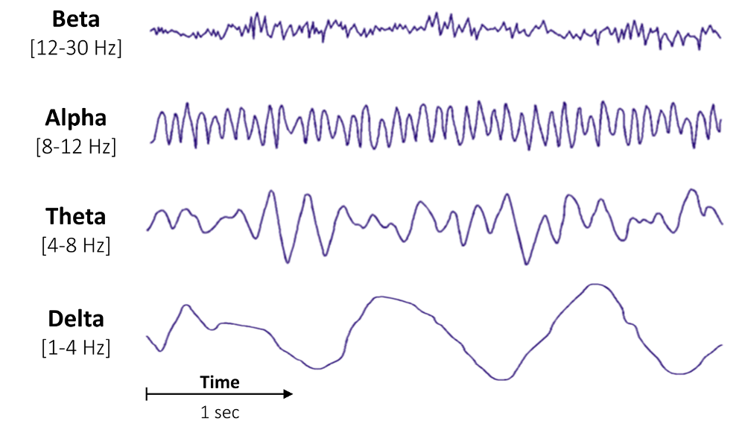
Interpretation of EEG signals
Decomposing the EEG signal into frequency bands
Raw EEG
Busy, active mind
Relaxed, passive attention
Drowsy, inward focused
Sleep
Source: ScienceDirect – Brain Waves

Slide 15
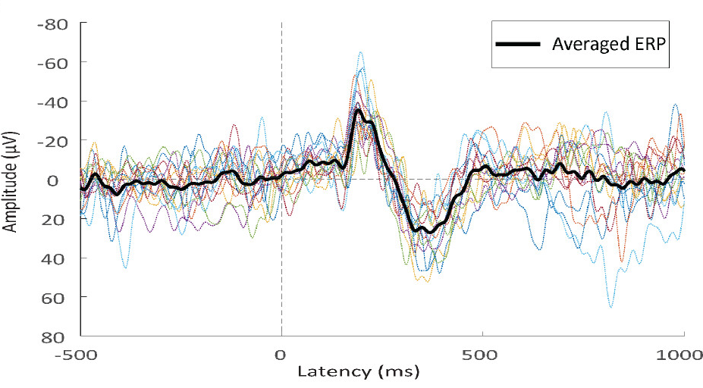
Interpretation of EEG signals
"Averaging" the EEG signals occuring around a stimulus -> event-related potential (ERP)
stimulus onset

Slide 16
Purposes
Medical: epilepsy, sleep disorders...
Research: psychiatric disorders, cognition, brain development, social and affective behavior, brain-computer interfaces, and so on...
Neuromarketing, neuroergonomics, etc....

Slide 17
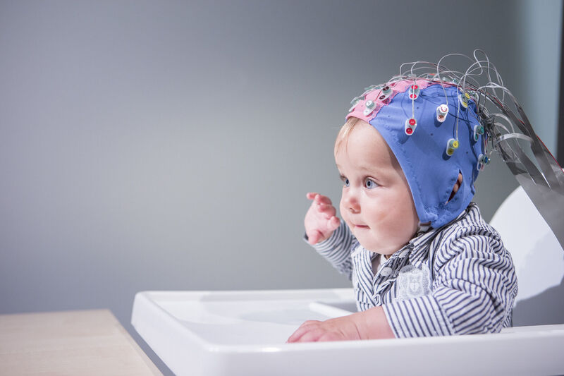
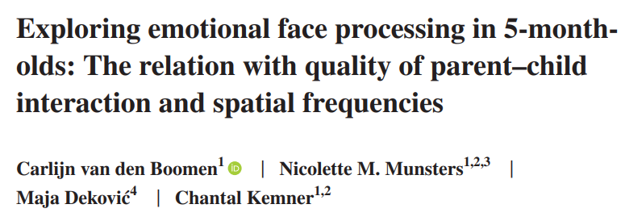
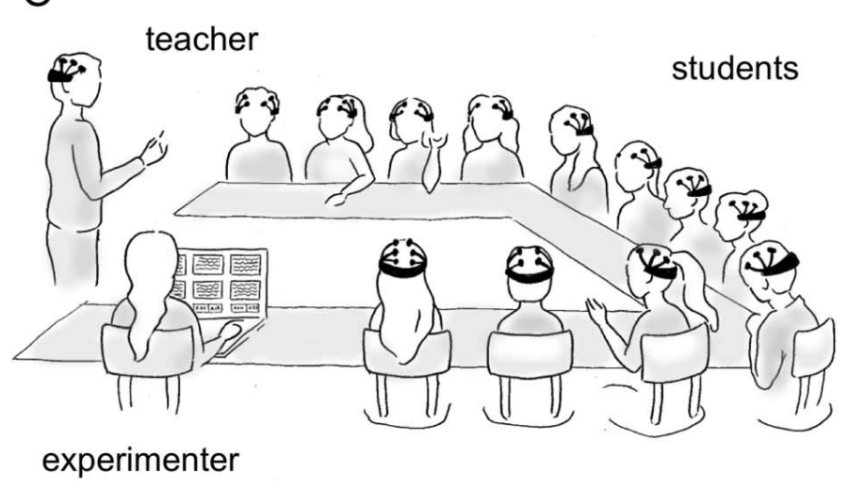
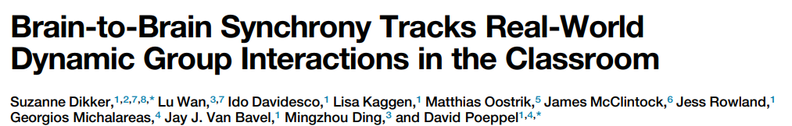
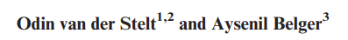
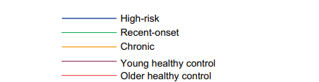
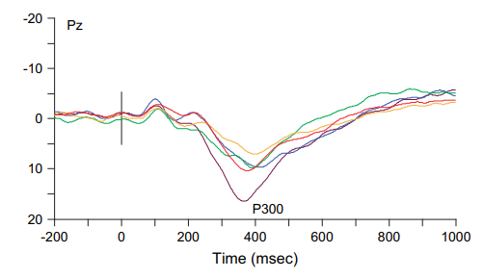
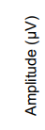
Examples ...

Slide 18
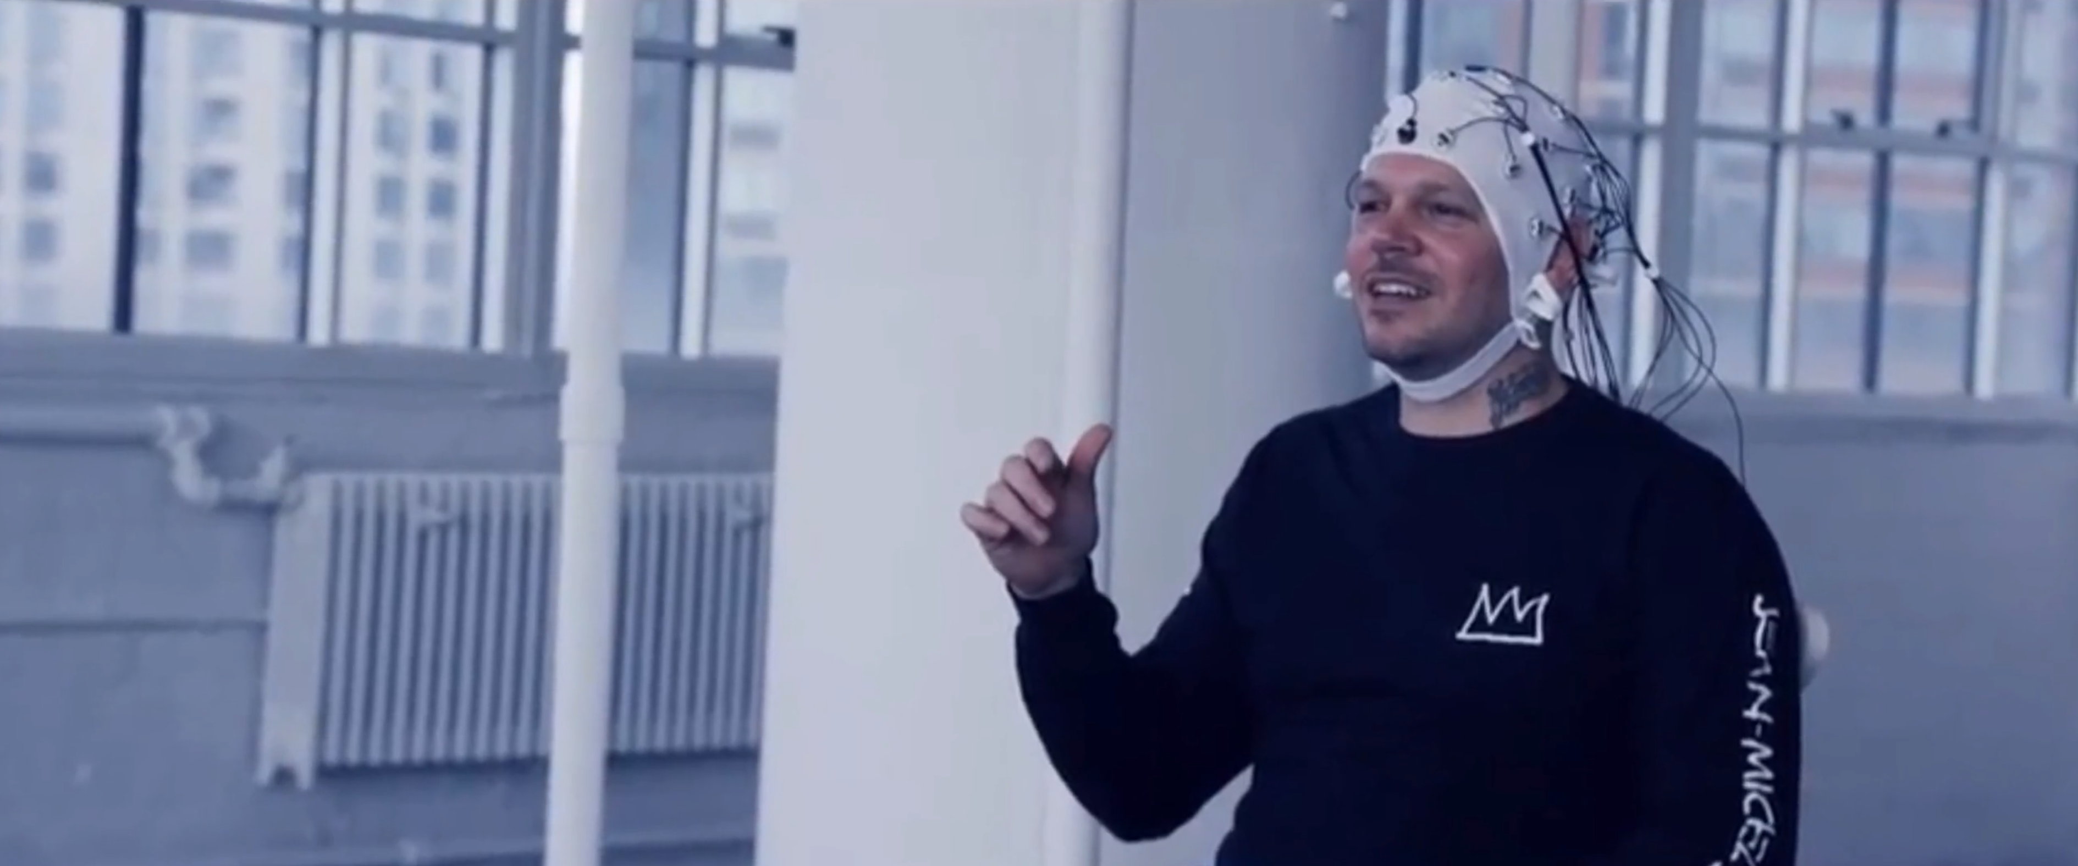
Musicians Residente & Bad Bunny synchronize – Dr. Suzanne Dikker (video @ https://www.suzannedikker.net/ )

Slide 19
Intro to the recording environment (Simulink)

Slide 20
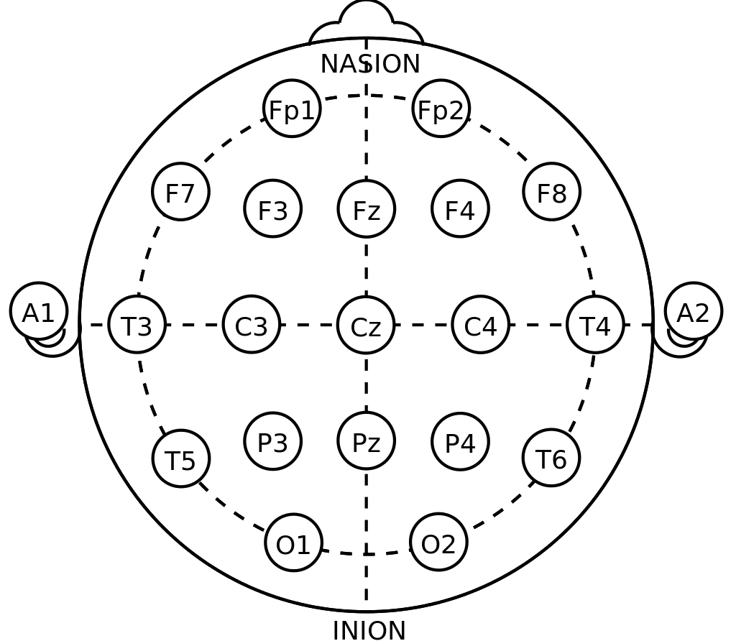
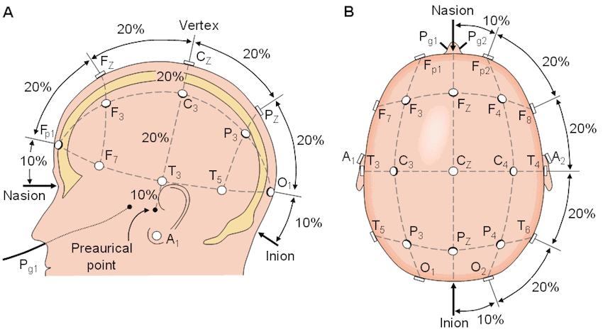
Things to know before recording
Electrode placement
10-20 system, proper placement
Naming, Numbers

Slide 21
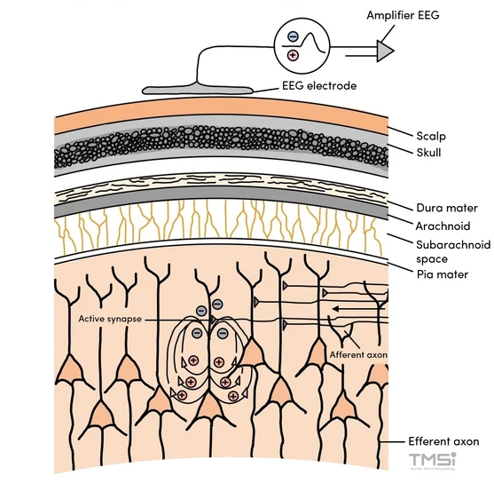
Things to know before recording
Signal Amplification and Impedance
EEG signals are typically very small in amplitude and require amplification

Slide 22
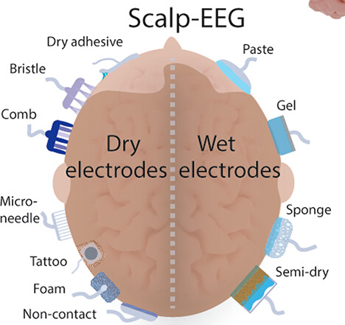
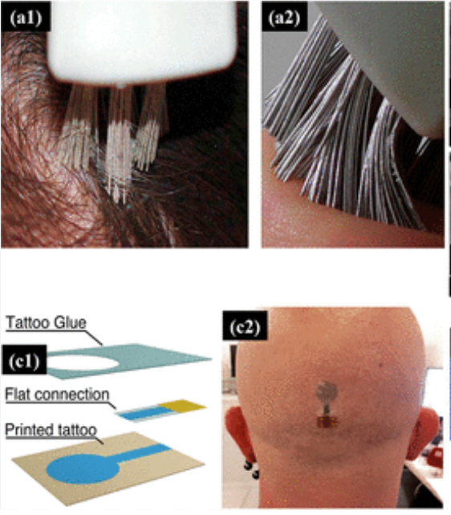
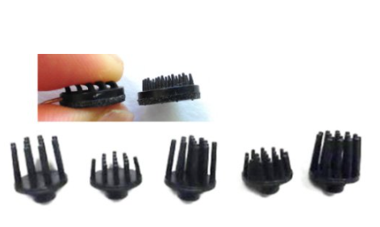
Things to know before recording
Signal Amplification and Impedance
Different kind of electrodes
Ag/AgCl (silver chloride)
Dry or Wet

Slide 23
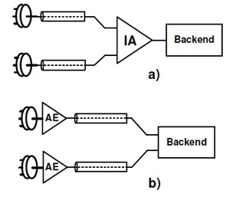
Things to know before recording
Signal Amplification and Impedance
Different kind of electrodes
Passive or Active
Active has a higher quality
Wire --> Amplifier
Passive
A
Passive
Active
A
A
Active
A
Amplifier --> Wire

Slide 24
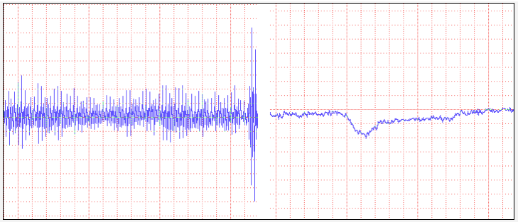
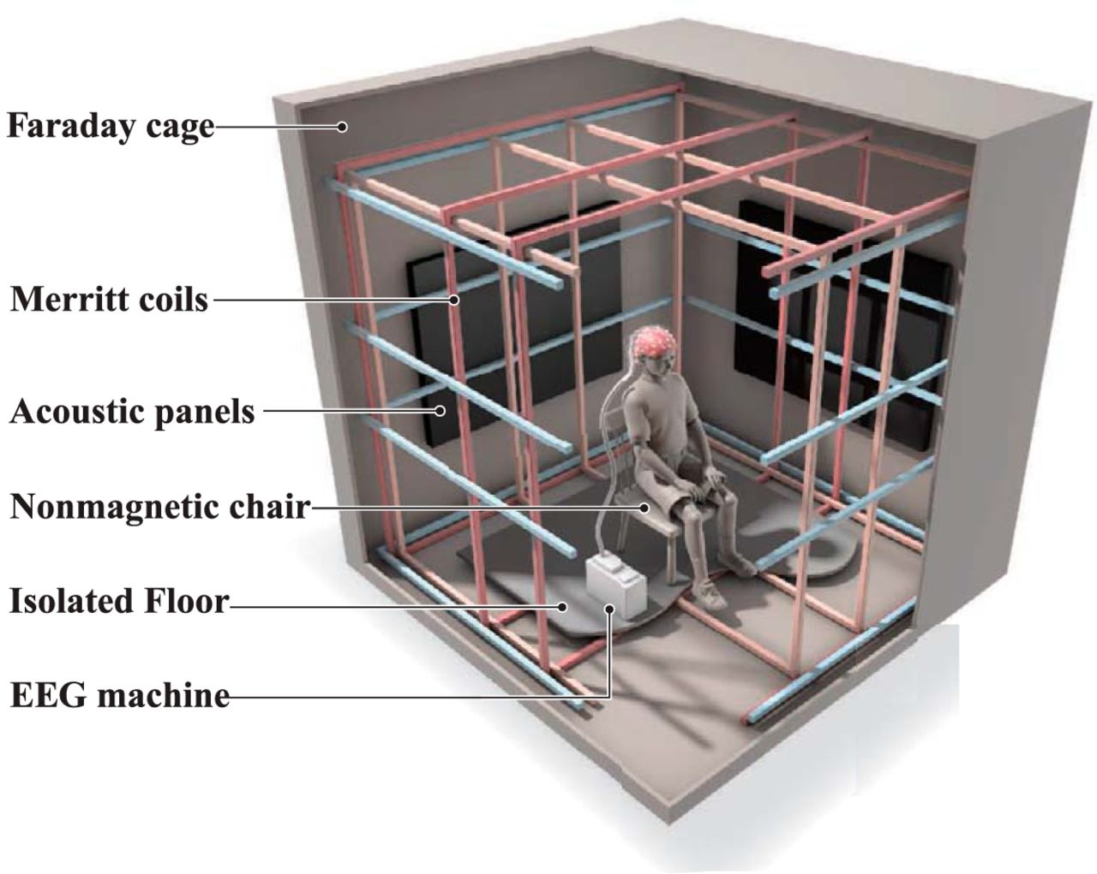
Things to know before recording
Environmental factors:
External electromagnetic fields, power line noise and Faraday cage
SNR, signal quality(signal to noise ratio)
CMRR higher is better (single amplifier)
(power line voltage presents commonly on both ends of amplifiers; it shouldn't amplify that noise; it should reject it)

Slide 25
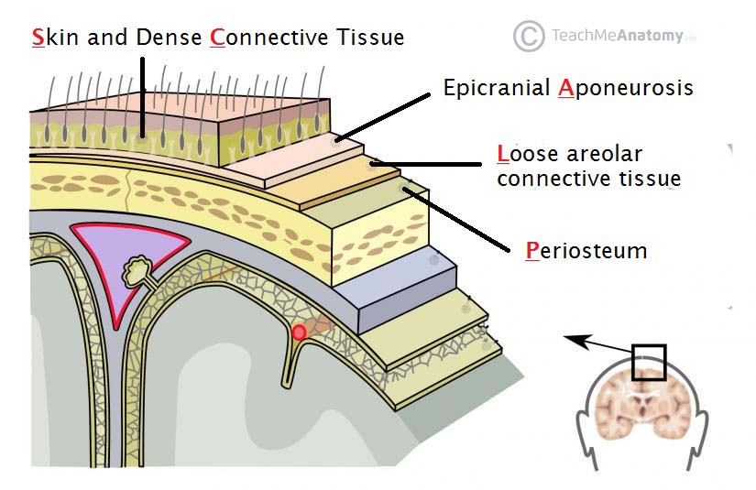
Things to know before recording
Sculp conductivity
Individual differences
men, women, baby, age, drinks, etc...
Skin moisture
hair thickness
presence of hair products

Slide 26
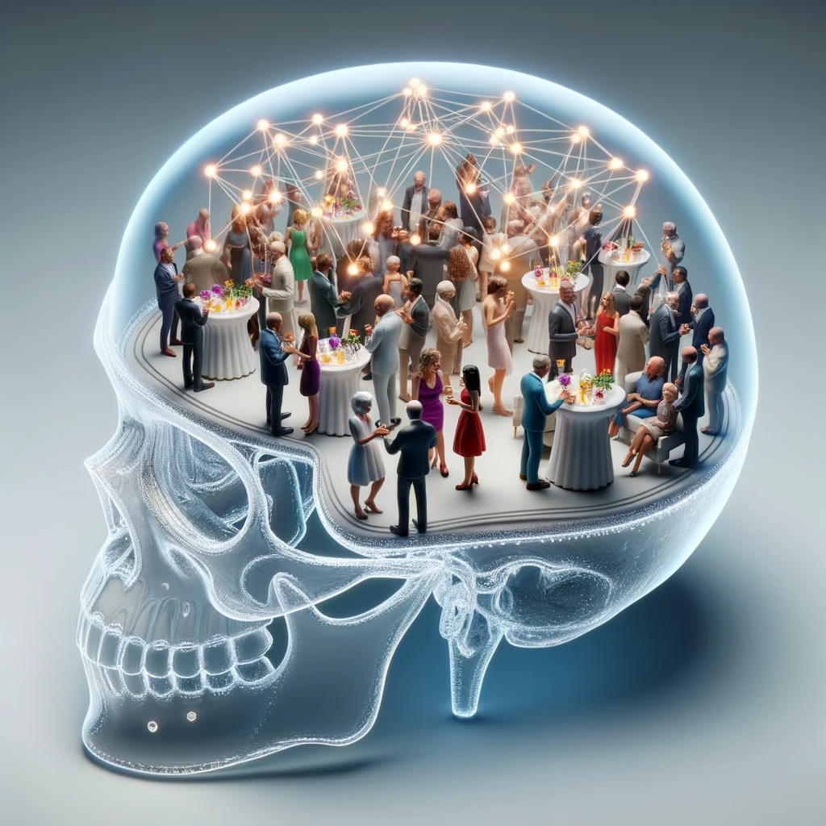
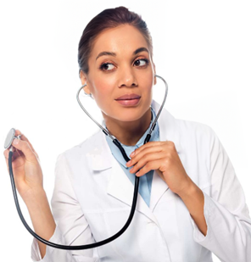
Things to know before recording
Volume conductance
Cocktail party analogy
Temporal and spatial resolution
Comparing EEG with other modalities like fNIRS and fMRI in this regard

Slide 27
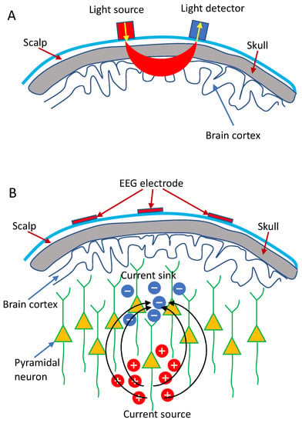
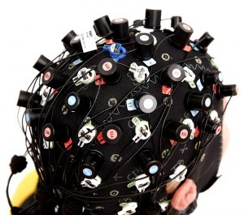
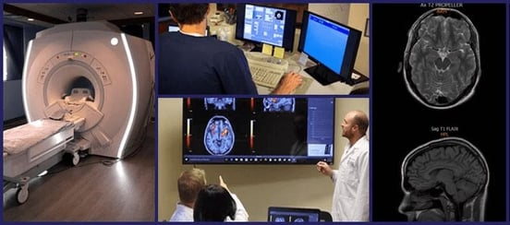
Things to know before recording
Temporal and spatial resolution
Comparing EEG with other modalities
fNIRS (functional near-infrared spectroscopy)
fMRI (functional magnetic resonance imaging)
Temporal resolution:
EEG : High (milliseconds)
fNIRS: Low (1-10 seconds)
fMRI : Low (1-5 seconds)
Spatial resolution:
EEG: Low (several centimeters)
fNIRS: Low (1-3 centimeters)
fMRI: High (1-5 millimeters in 3D)
Each have its own pros and cons and they also can be mixed

Slide 28
EEG Recording Environment
Overview of MATLAB Simulink
Brief introduction to Matlab Simulink
Advantages of using Simulink for EEG data processing
GUI, Visualized, Model based, Integration with Matlab, Extensive Signal Processing Toolbox, Realtime data processing

Slide 29
EEG Recording Environment
Integration of G.nautilus System with Simulink
Overview of G.nautilus 32-channel wireless EEG system
Steps to integrate the G.nautilus system with MATLAB Simulink

Slide 30
Configuration settings
Basic structure of a Simulink model for EEG recording (Pre-existing)
Visualization of real-time data acquisition in Simulink (Just run)
Important parameter configs before recording:
sampling rate
channel selection
filtering

Slide 31

Reference and Ground
Mono polar and bipolar :
Shorty mention during the recording
Shortly mention Ground and reference electrodes functionality:
Ground:
Common return path to close electrical circuit
Reference: (monopolar)
Stable comparison point for measuring the electric potential
Each electrode compare itself to the reference
Ground
Reference

Slide 32
EEG prep + Practical
Creating intentional problems during recording
How to treat a participant (Explanations, ethics, etc.)
Participant Comfort and Safety:
before study ask them to dress comfortably and don’t use hair gels and conditioners... (bring my announcement here)
Recap the previous session
Forget to turn amplifier on
Forget gel on one channel
Forget ear reference
Show impedance check and recording settings
Environmental factors like powerline noise
Show the data with and without notch filter (at least one channel)
Show artifacts, muscle movements, blinks
Alpha waves in rest (closed eyes)
How we count the alpha band frequency on a grid
What is the standard range of voltage for EEG?

Slide 33
ERP experiment
Auditory oddball task
Download link: https://github.com/MindLabs-Tilburg/EEGworkshop [please wait until experiment is over ;) ]
Also download one .set from: https://nemar.org/dataexplorer/detail?dataset_id=ds003061

Slide 34
Data analysis

Slide 35

Installing and starting EEGlab
Like adding any toolbox for Matlab

Slide 36
Outline (It will be projected on the screen while we do it)
Loading and visualizing data before pre-processing
Preprocessing the data
Filtering
Re-referencing
Resampling
Artifact removal
Eye rejection
ICA/ automated rejection
Source understanding
If you don't have events beware of stationarity in segmenting
Plot data
Time domain
features
Frequency domain
Features
Time frequency (if we had time )
Batch analysis and coding in Matlab

Slide 37

Filtering

Slide 38

ICA (independent component analysis)
With 7 mics you can separate up to 7 different sources of voice (7 tables)

Slide 39

ICA (independent component analysis)
Generalize that to a football match, and mass response of fans to a stimuli in the court

Slide 40
Time visualization features
The expected signal amplitude
Counting alpha wave on the grids
Etc.

Slide 41
Frequency visualization features
1/f spectral behavior
Noise harmonics
No harmonics for EEG power bands
Etc.

Slide 42
ERP
Use the .set file (already cleaned)
EEGLAB:
Extract epochs (small segments around stimuli)
Choose the stimuli of interest
e.g., noise vs target
Choose a baseline (e.g., -100 to 0)
Plot ERPs

Slide 43
References
https://zeto-inc.com/blog/active-and-passive-electrodes-what-are-they-pros-cons/
Advances in Electrode Materials for Scalp, Forehead, and Ear EEG: A Mini-Review
https://pubs.acs.org/doi/abs/10.1021/acsabm.3c00322
https://eegget-it.nl/eeg_electrodes.html
https://www.eneuro.org/content/6/2/ENEURO.0483-18.2019
https://www.mdpi.com/1424-8220/22/15/5865
https://eeglab.org/tutorials

Slide 44
And our special thanks to those who contributed to making this workshop possible:
Mirjam Siesling
Marijn van Wingerden
Eva Verschoor-Suitela
Drew Hendrickson
Maarten van Alem
Emmanuel Keuleers
Sarah Blain
Henry Brighton

